Slide 1
Whitening PCA
500 neurons at 12x12 resolution
PCA of color pixels have a 50/30/20 variance split for achromatic, blue/yellow and red/green.
Normalized RFs for size post-training, otherwise it doesn’t look nearly as good

Slide 2
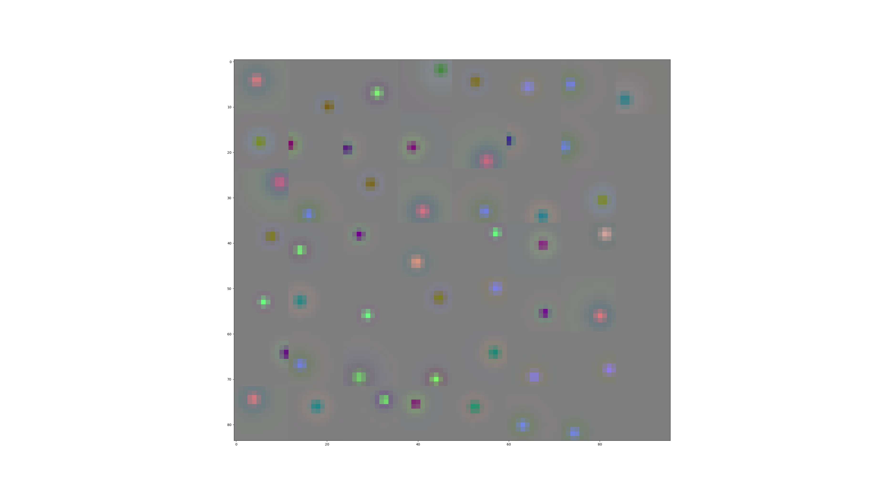

Slide 3
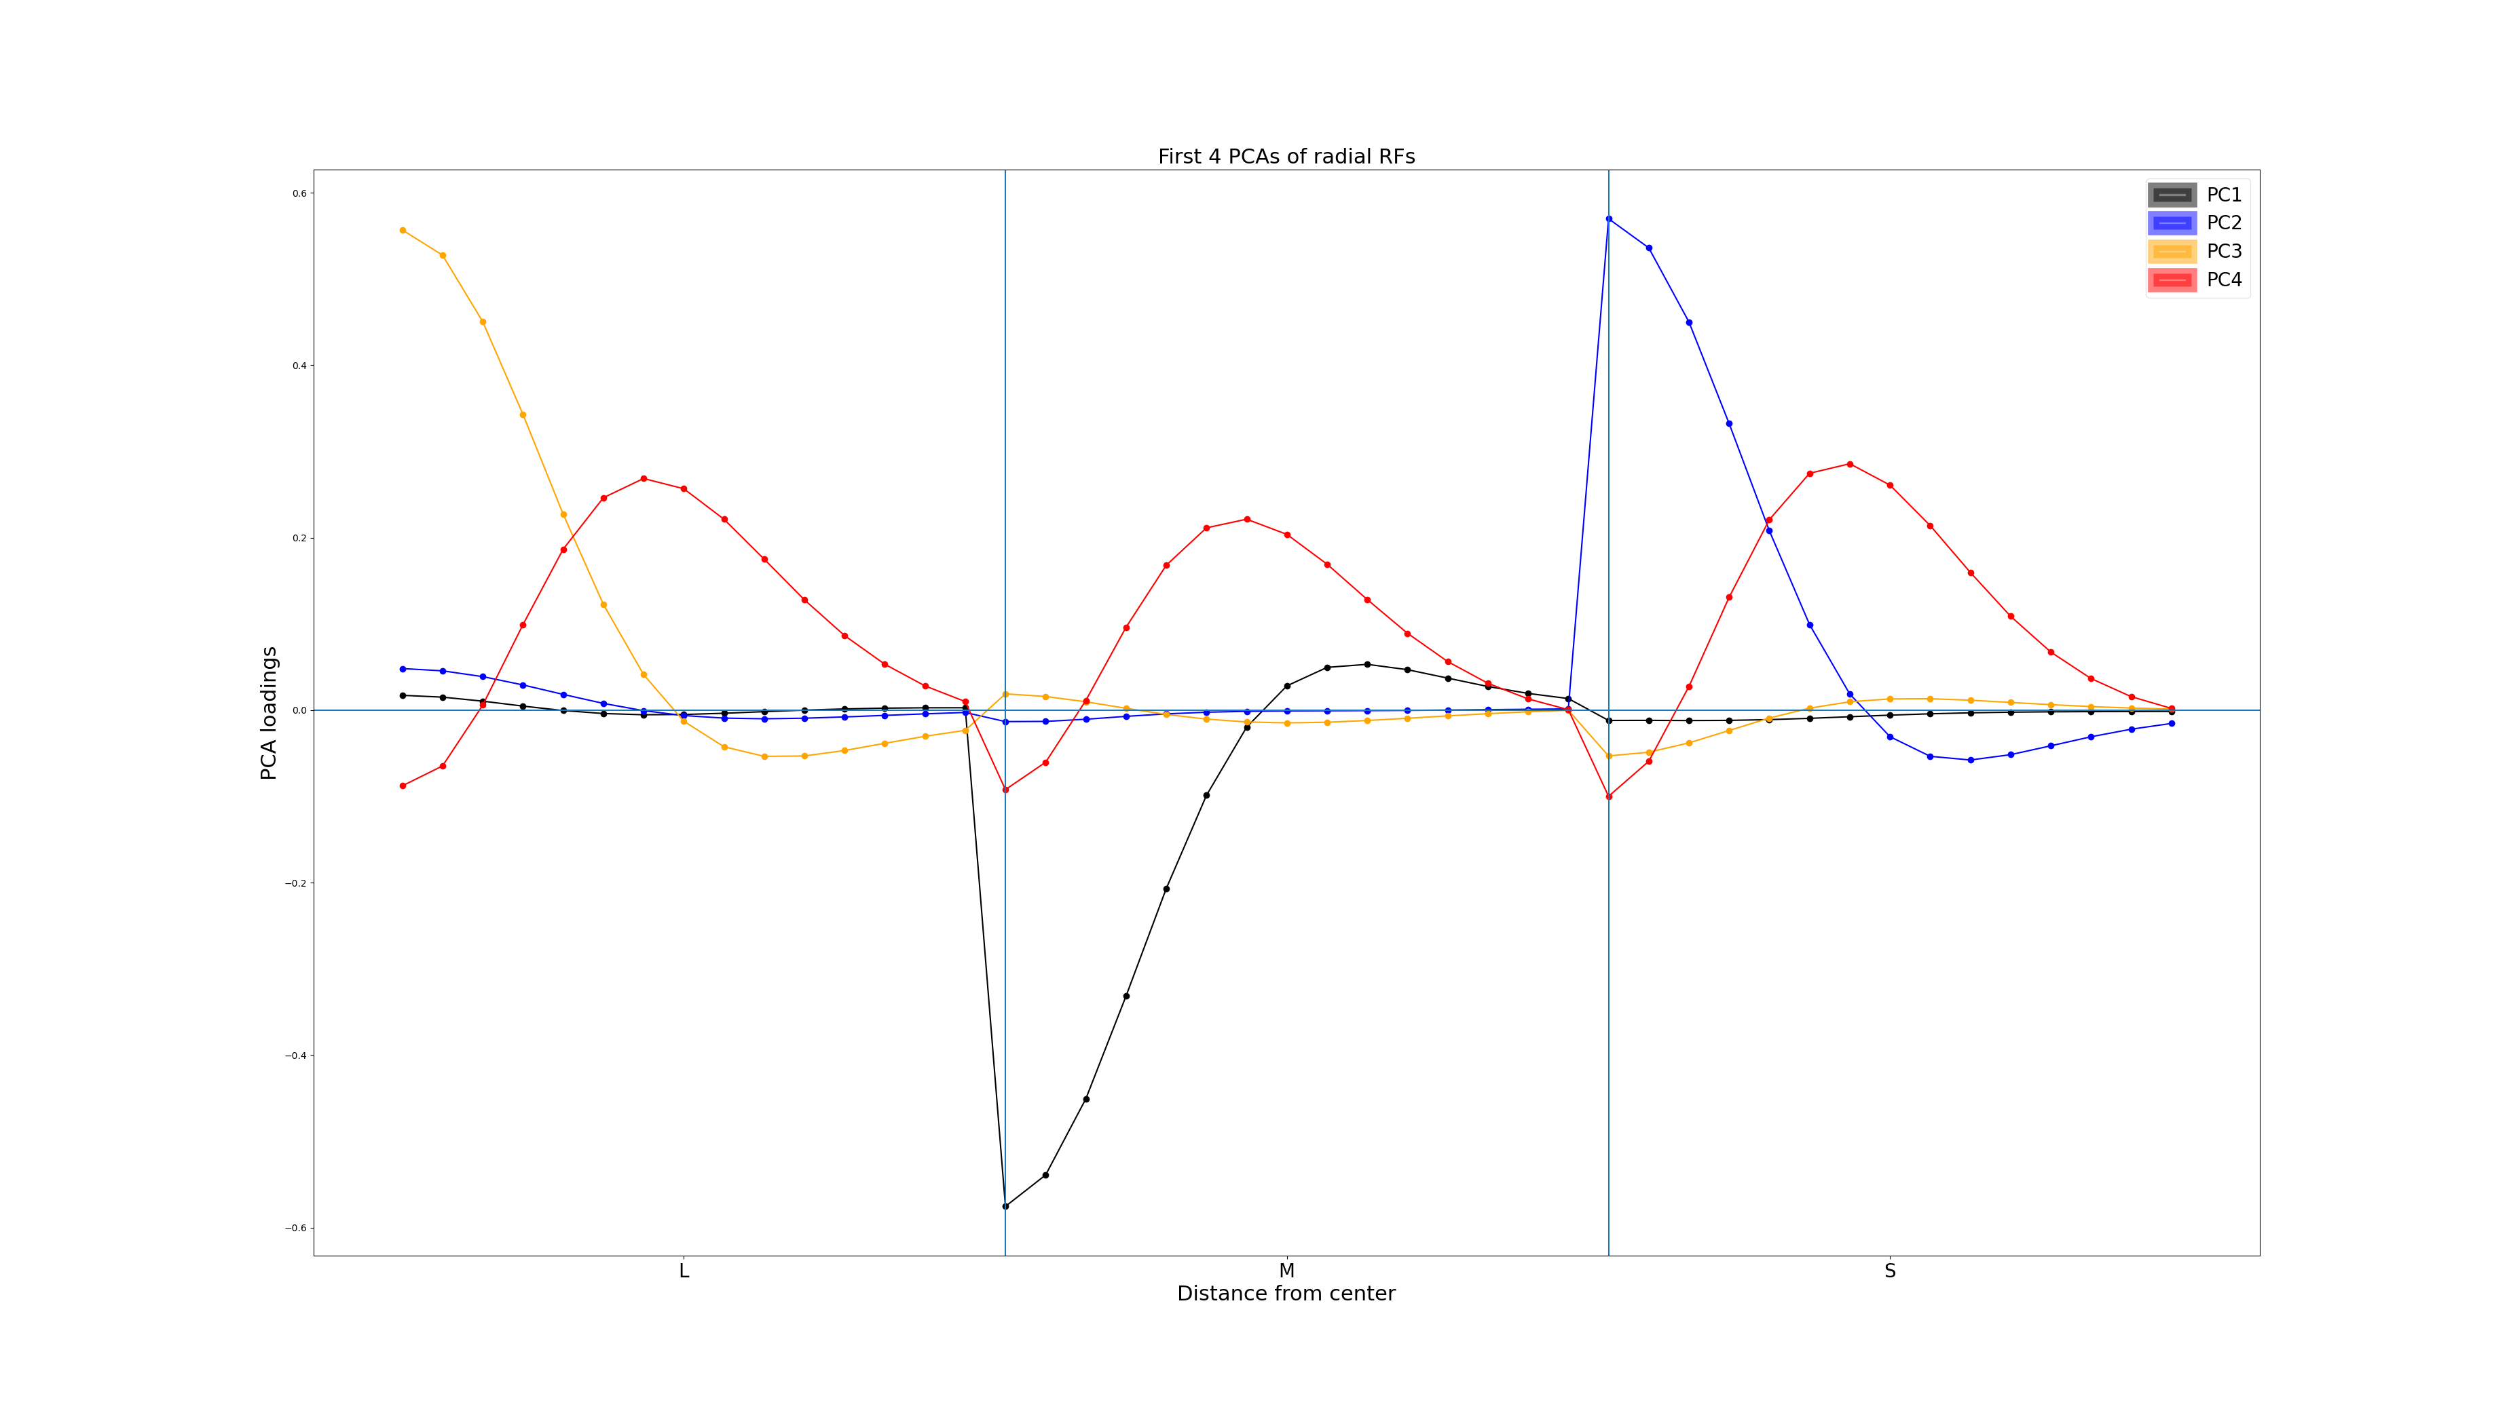

Slide 4
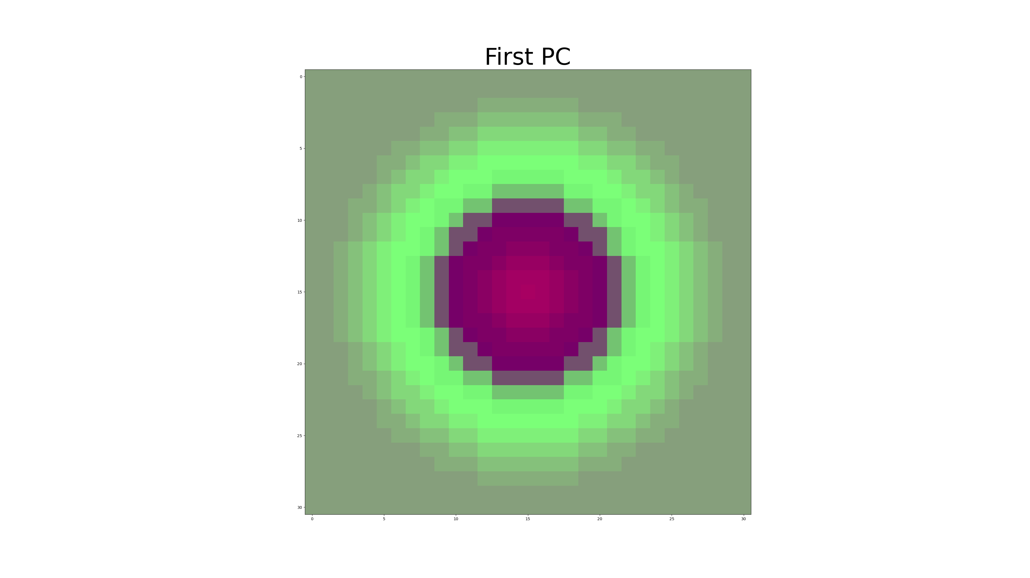
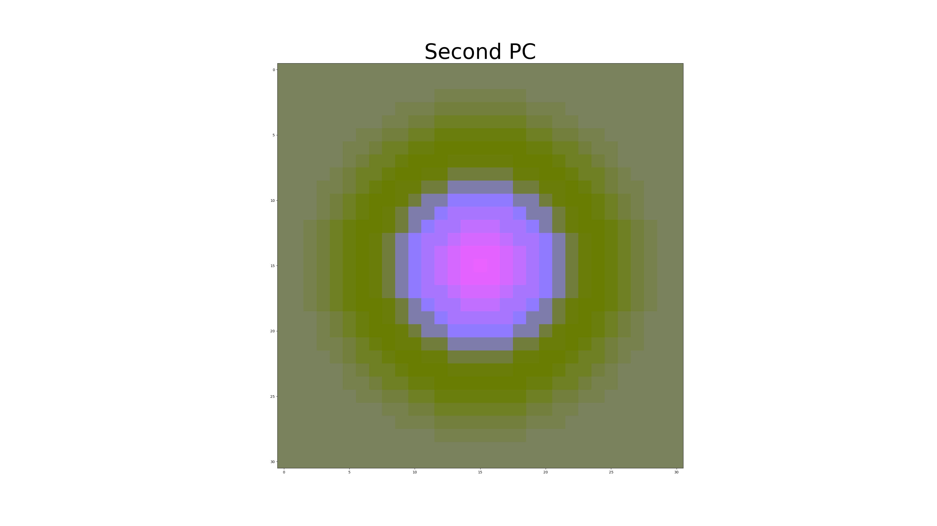
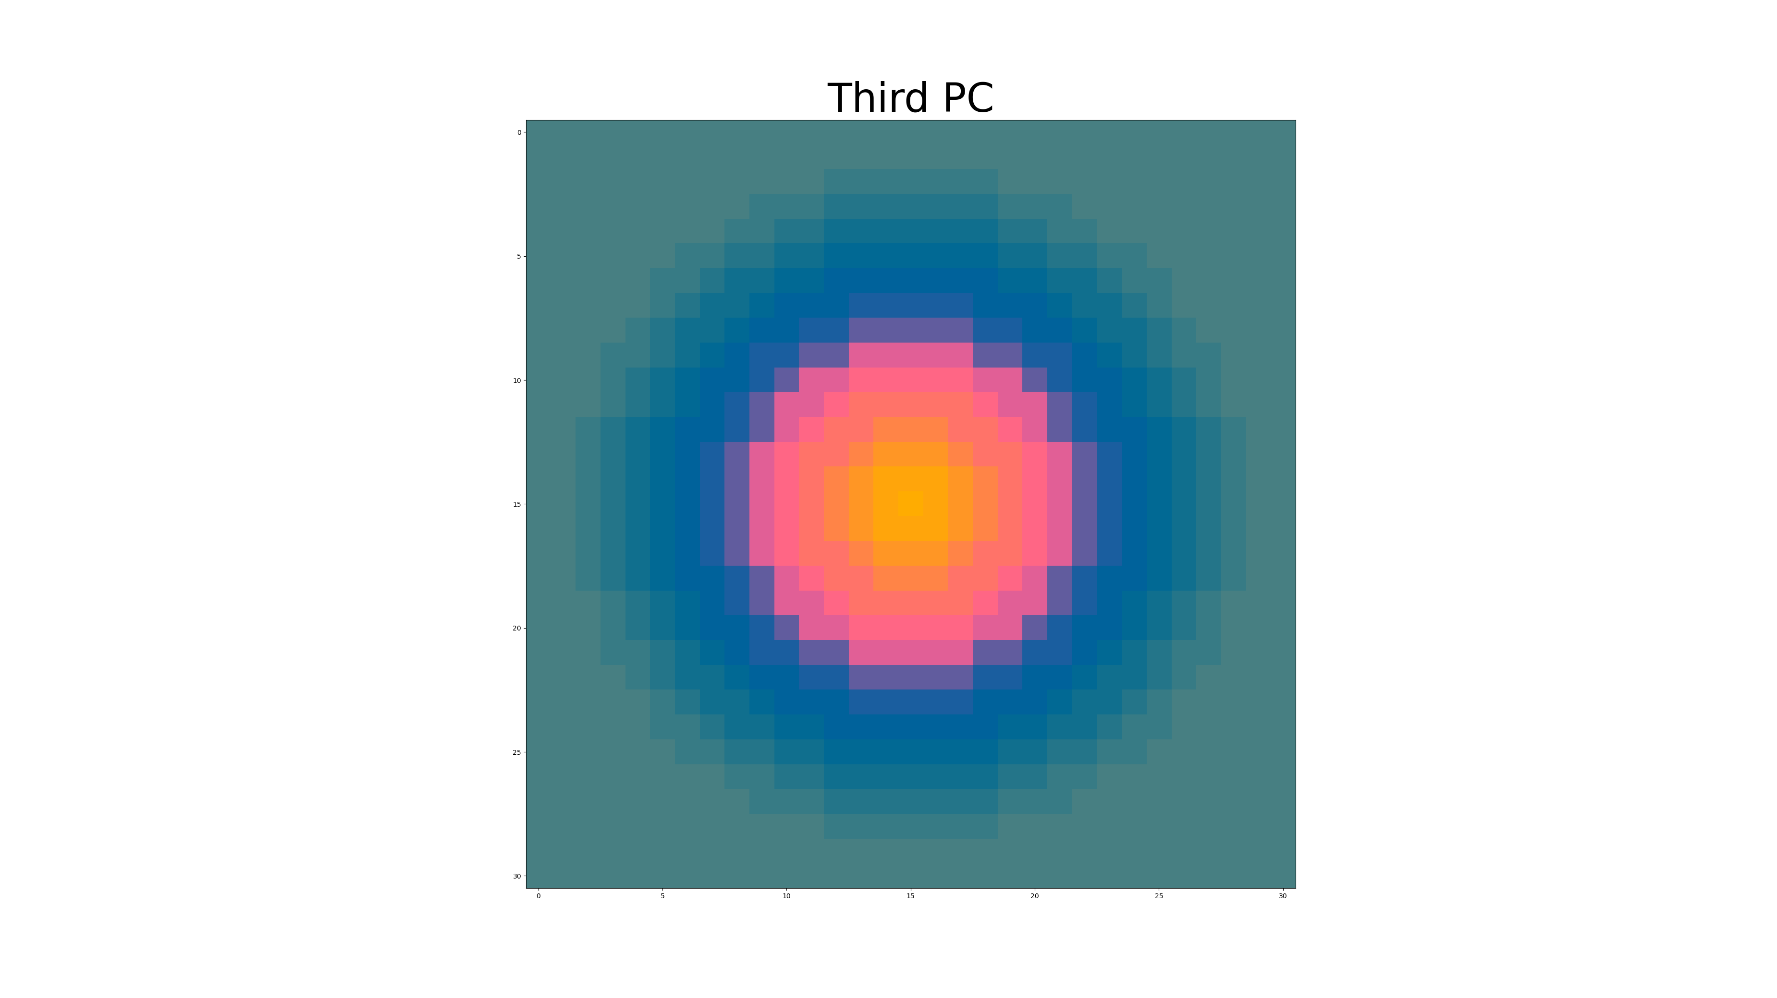
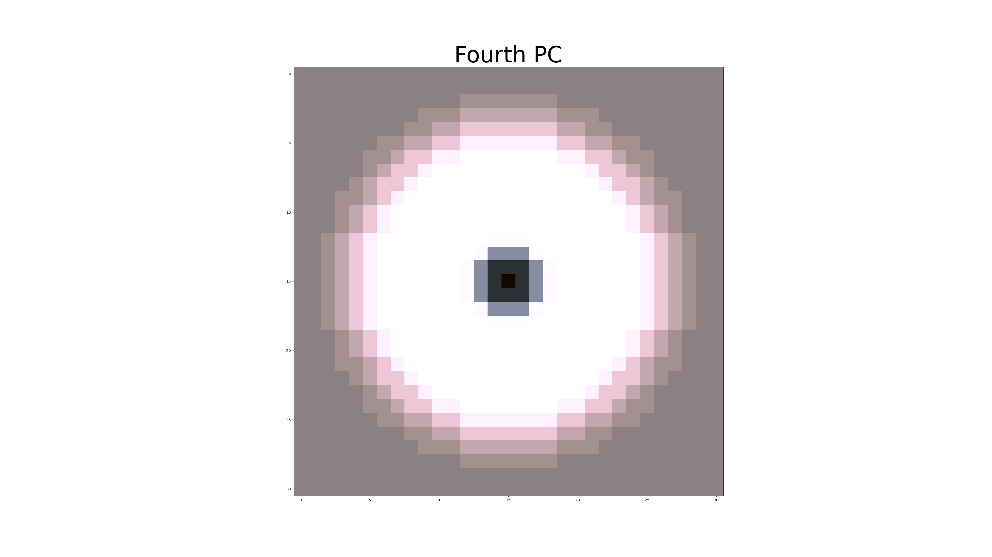

Slide 5
